Slide 1
PMBOK – BABOK
Which came first…the chicken or the egg?
Do we really need both?
November 2008
Errol Thomas
MCSE, CEA, PMP, CBAP

Slide 2
Book of Knowledge Origins
Project Management Body of Knowledge (PMBOK)
  First published in 1987 by the Project Management Institute (PMI)
  A framework that defines project management and related concepts, describes the project management life cycle, and outlines related processes
  Written with Project Managers in mind – PMP
Business Analysis Body of Knowledge (BABOK)
  First published in 2006 by the International Institute of Business Analysis (IIBA)
  A framework that describes Business Analysis areas of knowledge, their associated activities and tasks and the skills necessary to be effective in their execution
  Written with Business Analysts in mind – CBAP
November 2008
© 2008 Public Sector Consultants, Inc.

Slide 3
PMBOK Breakdown
Defines 5 main processes:
  Initiating
  Planning
  Executing
  Controlling
  Closing
Defines 9 knowledge areas:
  Project Scope Management
  Project Integration Management
  Project Time Management
  Project Cost Management
  Project Quality Management
  Project HR Management
  Project Risk Management
  Project Procurement Management
  Project Communications Management
November 2008
© 2008 Public Sector Consultants, Inc.

Slide 4
BABOK Breakdown
Defines 6 knowledge areas:
  Enterprise Analysis
  Requirements Planning and Management
  Requirements Elicitation
  Requirements Analysis and Documentation
  Requirements Communication
  Solution Assessment and Validation
November 2008
© 2008 Public Sector Consultants, Inc.

Slide 5
PMBOK & BABOK Compared
Words most used in PMBOK knowledge area titles:
  Project
  Management
Words most used in BABOK knowledge area titles:
  Requirements
Number of times these words appear in each BOK:
 | Appears in PMBOK | Appears in BABOK
Project | 239 times in Chapter 1 | 36 times in Chapter 1
Management | 111 times in Chapter 1 | 17 times in Chapter 1
Requirements | 13 times in Chapter 1 | 104 times in Chapter 1
November 2008
© 2008 Public Sector Consultants, Inc.

Slide 6
PMBOK & BABOK Compared
Mapping between PMBOK and BABOK knowledge areas
Project Scope Management Project Risk Management | Enterprise Analysis
Project Integration Management Project Time Management Project Cost Management Project HR Management | Requirements Planning and Management
Project Communications Management | Requirements Communication
Project Quality Management Project Procurement Management | Solution Assessment and Validation
Missing BABOK knowledge areas
  Requirements Elicitation
  Requirements Analysis and Documentation
November 2008
© 2008 Public Sector Consultants, Inc.

Slide 7
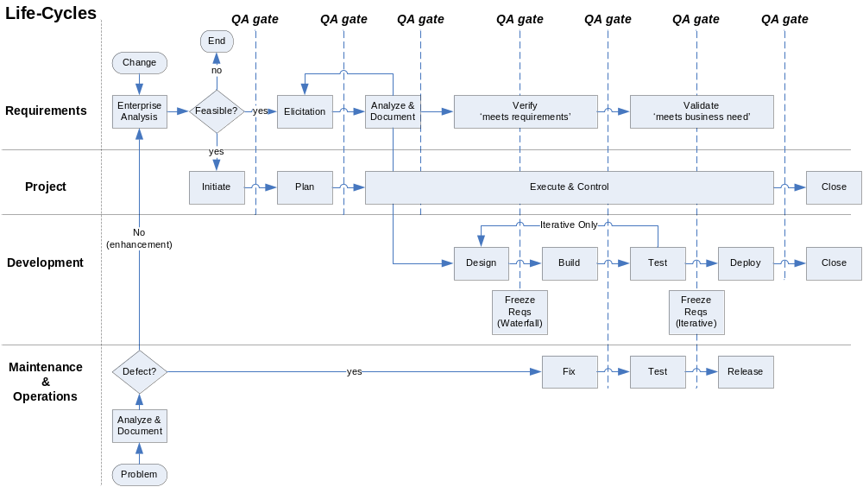
November 2008
© 2008 Public Sector Consultants, Inc.

Slide 8
Conclusions
Which came first…the chicken or the egg?
  Technically, the PMBOK came first
  However, it doesn’t matter!
Do we really need both?
  Yes!
  Both are value added
    PMBOK main focus is on project parameters
    BABOK main focus is on the product parameters
  Both have holes
    The PMBOK is not explicit about eliciting, analyzing and documenting requirements
    The BABOK is not explicit about all project management activities
  Two frameworks combined into a single methodology are better than when they stand alone
The PMBOK and BABOK together
  Complement each other with standardized definitions and terms for PM and BA activities
  Create local communities of PM and BA professionals to meet and discuss common experiences
  Provide certification models that establish consistent best practices and industry standards
  Provide a common understanding of knowledge and skills for PM and BA professions
November 2008
© 2008 Public Sector Consultants, Inc.

Slide 9
Questions and Answers
November 2008
© 2008 Public Sector Consultants, Inc.

